Slide 1
Cellular and Antibody Mediated Graft Rejection:
Please note some images will be redrawn
Slide titles will also be revised
Molecular Understanding and Clinical Impact

Slide 2
Overview
Antibody mediated rejection (ABMR) is now thought to be the major contributor to late graft rejection
T cell mediated rejection (TCMR) mechanisms can cause early graft rejection and may also play a role in late graft rejection
Understanding the molecular pathophysiology of both is a critical next step in order to:
Improve detection and diagnostics
Update Banff guidelines
Develop more targeted therapies
Treat graft rejection sooner and more effectively
Notes:
Greater specificity of immunosuppressive agents have improved early posttransplant outcomes^{1,2}
Outcomes as one year graft survival show almost 90% of all allografts still functioning at one year³
Long term graft survival appears more complex¹
Early events and markers (eg, acute rejection and renal function) do not appear to be reliable markers of long term graft survival¹
T Cell Mediated Rejection & Antibody Mediated Rejection are underestimated problems^{2,4}
ABMR is rapidly being accepted as chief cause of late graft rejection – replacing CNI nephrotoxicity²
Pathophysiology of immunologic rejection is still not well understood – and needs to be in order to detect all cases of immunologic rejection and treat appropriately^{2,4}
The goal and hope is that now that it is understood what an impact immune mediate injury makes – elucidating its MOD will improve treatment and improve 5 year outcomes
References
1. Kaplan B, Meier-Kriesche HU. Renal Transplantation: A Half Century of Success and the Long Road Ahead. J Am Soc Nephrol. 2004; 41 3270-3271.
2. Webber A, Hirose R, Vincenti F. Novel Strategies in Immunosuppression: Issues in Perspective. Transplantation. 2011;91:1057–1064.
3. Chandraker A, Milford EL, Sayegh MH. Chapter 282. Transplantation in the Treatment of Renal Failure. In: Longo DL, Fauci AS, Kasper DL, Hauser SL, Jameson JL, Loscalzo J, eds. Harrison's Principles of Internal Medicine. 18th ed. New York: McGraw-Hill; 2012.
4. Wood KJ, Goto R. Mechanisms of rejection: current perspectives. Transplantation. Jan 15 2012;93(1):1-10.

Slide 3
T Cell Mediated Rejection (TCMR)

Slide 4
TCMR – Molecular Mechanisms Create Histophathology Lesions
T cells induce local epithelial changes – the key change being epithelial dedifferentiation
This dedifferentiation compromises epithelial integrity and permits entry of lymphocytes, causing lesions
1. Halloran PF. Am J Transplant. May 2010;10(5):1126-1134.
Notes:
Advances in immunosuppression have reduced but not eliminated TCMR and it remains an important problem
T cell mediated rejection must be recognized, treated and distinguished from other conditions
Molecular mechanisms of TCMR are poorly understood and to improve clinical outcomes, understanding these mechanisms is important
This model aims to explain how molecular mechanisms create the diagnostic histopathology lesions – interstitial infiltrate and tubulitis
Effector T cells engage donor antigen on macrophages
Creates inflammatory compartment that recruits effector and effector memory CD4 and CD8 T cells
T cells cross the donor microcirculation and enter the interstitium
Local inflammation triggers dedifferentiation of the adjacent epithelium
Local epithelial changes trigger a response of the entire nephron and a second wave of dedifferentiation
The dedifferentiated epithelium is unable to exclude T cells, which enter to produce tubulitis lesions
This models shows TCMR mediated by a local process analogous to delayed-type hypersensitivity where the key change is epithelial dedifferentiation
References
Famulski KS, Einecke G, Sis B, et al. Defining the canonical form of T-cell-mediated rejection in human kidney transplants. Am J Transplant. Apr 2010;10(4):810-820
Einecke G, Mengel M, Hidalgo L, Allanach K, Famulski KS, Halloran PF. The early course of kidney allograft rejection: defining the time when rejection begins. Am J Transplant. Mar 2009;9(3):483-493.
Halloran PF. T cell-mediated rejection of kidney transplants: a personal viewpoint. Am J Transplant. May 2010;10(5):1126-1134.

Slide 5
TCMR – Activating the T Cells
In the graft and the surrounding tissues, donor and host dendritic cells activate and move to secondary lymphoid organs
There, they engage alloantigen-reactive T cells which recirculate between lymphoid compartments
Halloran PF. N Engl J Med 2004;351:2715-29.
Notes:
An overview of current understanding of MOD
T cell must recognize the antigen
Antigen-presenting cells (APC) migrate to T cell areas of secondary lymphoid organs
APCs present donor antigen to naïve and memory T cells
T cells are activated and undergo clonal expansion and differentiation to express effector functions (details of this process explained on next slide)
When the graft is infiltrated by effector T cells and other immune cells, it displays altered capillary permeability and deterioration of parenchymal function
When the T cells invade the kidney tubules and small arteries, diagnostic lesions show tubulitis and arteritis, respectively
References
Halloran PF. Immunosuppressive Drugs for Kidney Transplantation. N Engl J Med 2004;351:2715-29.

Slide 6
TCMR- How the T Cells Proliferate and Reach the Graft to Cause Inflammation
T cell activation and proliferation occurs via three signal pathways
Many steps in the transduction pathways are therapeutic targets
The end result of these three pathways is large numbers of effector T cells are created which leave the lymphoid tissue to infiltrate the graft creating an inflammatory response
Halloran PF. N Engl J Med 2004;351:2715-29.
Notes:
After antigen recognition by T cells, an immunologic synapse is formed resulting in the clustering of costimulation, signaling, and adhesion molecules
Signal transduction pathways are triggered alternating gene transcription in the activated T cell. This is categorized into a “three signal model” :
Signal 1 – transduced through the CB3 complex
Signal 2 – costimulation delivered when CD80 and CD86 engage CD28 on T cells
Signals 1 and 2 activate three pathways (calcium-calcineurin, MAP Kinase, NFkB) which result in expression of IL-2, CD154, CD25 and other molecules
Signal 3 - IL-2 and other cytokines activate the mTOR pathway which is the trigger for cell proliferation
This leads to a large number of effector T cells
Effector T cells that leave lymphoid tissue and infiltrate the graft tissue lead to an inflammatory response
References
Halloran PF. Immunosuppressive Drugs for Kidney Transplantation. N Engl J Med 2004;351:2715-29.

Slide 7
Banff Histology Guidelines Were a useful First Step at Diagnosing TCMR
Banff guidelines define TCMR by histopathologic features¹
Interstitial inflammation (i-score ≥ 2)
Tubulitis (tscore ≥ 2)
And/or intimal arteritis (v-score > 0)
This is the current gold standard, but is an imperfect one
Glomerulitis showing extensive capillary occlusion by endothelial swelling and accumulation of
monocytes (PAS, x 120)
Racusen LC, et al. Kidney Int. 1999; 55:713–723.
Racusen LC, et al. Kidney Int. 1993; 44:411–422. (image)
Notes:
TCMR in kidney allografts is defined by its histopathologic features.
References
Racusen LC, Solez K, Colvin RB et al. The Banff 97 working classification of renal allograft pathology. Kidney Int. 1999; 55:713–723.

Slide 8
Banff Guidelines Have Limitation and Need To Be Refined
Same histologic features are seen in:
Renal injury, infection, glomerulonephritis^{1,2}
Well-functioning kidney transplants^{1,2}
Intimal arteritis also occurs in antibody mediated rejection (ABMR) and is therefore not a specific TCMR indicator²
TCMR manifestations modified by drugs may escape detection²
A molecular definition of TCMR could offer more precise diagnosis to these cases²
1. Einecke G, et al. Am J Transplant. Mar 2009;9(3):483-493.
2.Famulski KS, et al. Am J Transplant. 2010; 10:810-820.
Notes:
Banff histological guidelines may not be specific enough to capture all instances of TCMR
Problematically, interstitial infiltrate and tubulitis histology patterns are also seen in:
Renal injury, infection, and glomerulonephritis
Protocol biopsies of well-functioning kidney transplants
The threshold for diagnosing TCMR also has potential for errors as intimal arteritis also occurs in ABMR, not just TCMR
Manifestations of TCMR may be modified by drugs which can have monocyte related TCMR, and a heavy T-cell infiltrate is not necessary
References
Einecke G, Mengel M, Hidalgo L, Allanach K, Famulski KS, Halloran PF. The early course of kidney allograft rejection: defining the time when rejection begins. Am J Transplant. Mar 2009;9(3):483-493.
Famulski K.S, Einicke G, Sis B, Mengel M, Hidalgo L.G, Kaplan B, Halloran P.F. Defining the Canonical Form of T-Cell-Mediated Rejection in Human Kidney Transplants. Am J Transplant. 2010; 10:810-820.

Slide 9
A Molecular Definition of TCMR Will Help Improve Banff Guidelines
Background:
Histopathology is an imperfect gold standard
Comparisons of transcripts to histologic lesions revealed inconsistencies with Banff diagnostic labels, for example:
Tubulitis grades t1 and t2 have identical molecular abnormalities
Some biopsies labeled ‘borderline’ are actually typical TCMR
To refine Banff labels, a molecular definition of TCMR was derived
This definition identified a transcript pattern that is:
Independent of histology knowledge
Not seen in ABMR and rare in other types of biopsies
1. Reeve J, et al. Am J Transplant. 2009; 9: 1802–1810.
2.Famulski KS, et al. Am J Transplant. 2010; 10:810-820.
3. Famulski KS, et al. Am J Transplant. 2010; 10:489-496.
Notes:
Histopathology is subjective and opinion based, and therefore an imperfect gold standard¹
Rejection-specific gene sets that include immunity- and inflammation-related transcripts, once identified can be compared to histopathology to verify accuracy of label and refine diagnosis to a molecular definition¹
The limitations of Banff guidelines were seen in studies that compared changes in transcripts to histologic lesions and Banff diagnostic labels Briefly, those studies demonstrated overall correlation of transcripts with Banff features, excepting three areas. Transcripts indicated:
Banff distinction of tubulitis grade t1 from t2 does not appear valid because t1 and t2 had identical molecular abnormalities
Some biopsies that Banff labels TCMR lack molecular features of TCMR
Some biopsies labeled ‘borderline’ are actually typical TCMR
They appplied a previously developed molecular definition of a canonical TCMR (cTCMR) derived in mouse kidney transplants to human kidney biopsies to see the features and outcomes of kidneys with cTCMR
The definition is based on high expression of transcripts reflecting IFNG effects (IFNG-induced transcripts or GRIT) and alternative macrophage activation (by alternative macrophage activation transcripts – or AMAT)
Evaluated 234 biopsies for cause (deterioration in function, proteinuria, stable impaired function)
Results:
GRIT1-AMAT1 combination provided definition of the cTCMR independent of knowledge of histology
The cTCMR pattern did not occur in C4d positive ABMR, and was rare in other biopsies
“Paradoxically, kidneys with cTCMR had the most intense inflammation but the best prognosis in terms of recovery of function and survival, despite features previously considered high risks for loss—intimal arteritis (v scores) and late presentation, reflecting the striking sensitivity of TCMR to current therapy when uncomplicated by ABMR”
To note, this is not a diagnostic test yet that has undergone sensitivity and specificity requirements, though that is being studied
Results
Provided definition of the cTCMR independent of knowledge of histology
The cTCMR pattern did not occur in C4d positive ABMR, and was rare in other biopsies
“Paradoxically, kidneys with cTCMR had the most intense inflammation but the best prognosis in terms of recovery of function and survival, despite features previously considered high risks for loss—intimal arteritis (v scores) and late presentation, reflecting the striking sensitivity of TCMR to current therapy when uncomplicated by ABMR”
References
Reeve J, Einecke G, Mengel M et al. Diagnosing rejection in renal transplants: A comparison of molecular- and histopathology-based approaches. Am J Transplant. 2009; 9: 1802–1810.
Famulski K.S, Einicke G, Sis B, Mengel M, Hidalgo L.G, Kaplan B, Halloran P.F. Defining the Canonical Form of T-Cell-Mediated Rejection in Human Kidney Transplants. Am J Transplant. 2010; 10:810-820.
Famulski K.S, Kayser D, Einicke G, Allanach K, Badr D, Sis B, Halloran P.F. Alternative Macrophage Activation-Associated Transcripts in T-Cell-Mediated Rejection of Mouse Kidney Allografts. Am J Transplant. 2010; 10:489-496.

Slide 10
Capturing All Episodes of TCMR Requires Molecular Detail
TCMR continues to be an important problem in transplant
A clear understanding of the MOD can:
Help diagnose TCMR
Differentiate TCMR from other diseases with similar presentations
Afford timely and accurate therapeutic intervention
Early and accurate detection is critical
TCMR tissue damage may:
Precede clinical symptoms
Contribute to late graft rejection as well as cause early rejection
Lead to possible irreversible nephron loss if left untreated
1. Halloran PF. Am J Transplant. May 2010;10(5):1126-1134.
2. Einecke G, et al. Am J Transplant. Mar 2009;9(3):483-493.
3. Famulski KS, et al Am J Transplant. 2010; 10:489-496.
Notes:
References
Halloran PF. T cell-mediated rejection of kidney transplants: a personal viewpoint. Am J Transplant. May 2010;10(5):1126-1134.
Einecke G, Mengel M, Hidalgo L, Allanach K, Famulski KS, Halloran PF. The early course of kidney allograft rejection: defining the time when rejection begins. Am J Transplant. Mar 2009;9(3):483-493.
Famulski K.S, Kayser D, Einicke G, Allanach K, Badr D, Sis B, Halloran P.F. Alternative Macrophage Activation-Associated Transcripts in T-Cell-Mediated Rejection of Mouse Kidney Allografts. Am J Transplant. 2010; 10:489-496.

Slide 11
Antibody Mediated Rejection (ABMR)

Slide 12
ABMR – Antibodies, B Cells and T Cells
For decades, only T cells were implicated in immune mediated allograft rejection, in part because animal model with no T cells did not exhibit rejection
The past decade has seen a shift in that thinking, and though T cells can create cellular rejection at any time posttransplant, antibody mediated rejection (ABMR) is the main contributor to late graft rejection
However, though the primary cell type in ABMR are B cells, alloantibody response generally requires T cell help
Colvin RB, et al. Nature Immunology Review. 2005; 5:805-817.
Notes:
Reference
1. Colvin RB, Smith RN. Antibody-mediated organ-allograft rejection. Nature Immunology Review. 2005; 5:805-817.

Slide 13
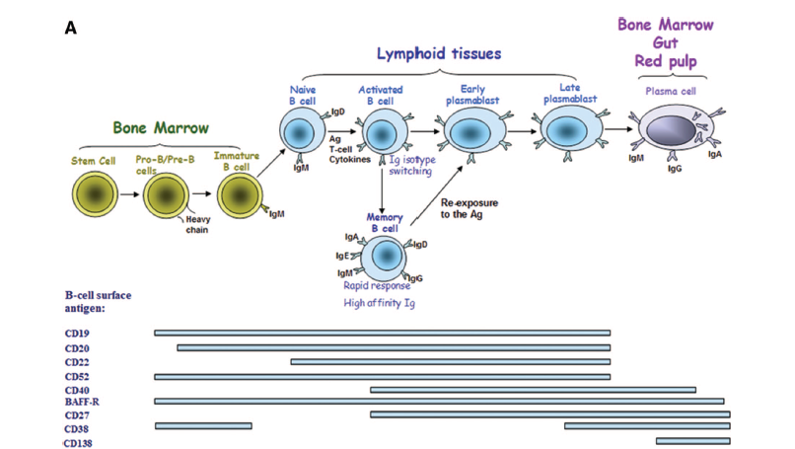
B cell Development, Activation and relationship to T cells
Naïve B-cells become activated by antigen, T cell co-stimulation and cytokines
The role of Treg cells in this process and in relationship to various depletion protocols is currently being investigated for clinical application
B-cells have been shown to play a dominant role in allograft rejection when T-cells were depleted or suppressed depletion of B-cells could not prevent a T-cell driven rejection
FPO
Notes:
B-cells develop throughout life in bone marrow
After the developing B-cells express antigen receptors, these molecules stimulate proliferation
Absent antigen receptor expression, developing B-cells undergo apoptosis
Naïve B-cells recognize soluble antigen in the blood or lymph using their B-cell receptor (BCR) and bind major histocompatibility complex (MHC) class II
This antigen/MHC II complex is recognized by compatible T-cells
Naïve B-cells become activated by antigen, T-cell co-stimulation and cytokines
On activation, B-cells exit the follicles into the T-cell zones of the lymphoid organ
Activated B-cells differentiate into either memory B-cells or early plasmablasts
Joanna Wieckiewicz, Ryoichi Goto, and Kathryn J Wood. T regulatory cells and the control of alloimmunity: from characterisation to clinical application. Curr Opin Immunol. 2010; 22(5): 662–668.
Reference
1. Zarkhin V, Li L, Sarwal M. “To B or Not to B?” B-Cells and Graft Rejection. Transplantation 2008;85: 1705–1714.

Slide 14
T Cell Regulatory Mechanisms
Images will be combined/simplified
Regulatory T (Treg) cells – which used to be called T cell suppressors - help maintain immune homeostasis and moderate inflammation ^{1,2}
The appropriate balance between T effector and Treg is critical²
In transplant, Tregs have been implicated in the active control of rejection responses and may have important therapeutic potential
1. Joanna Wieckiewicz, et al.Curr Opin Immunol. 2010; 22(5): 662–668.
Notes:
Several regulatory mechanisms are used to maintain immune homeostasis, prevent autoimmunity and moderate inflammation - chief among these are regulatory T (Treg) cells^{1,2}
The appropriate balance between effector (Teff) and T regulatory cells (Treg) is critical²
Although Treg cells play a pivotal role in limiting or preventing autoimmune and chronic inflammatory diseases, they also block some beneficial responses and can limit anti-tumor immunity¹
In the transplant setting, findings have implicated the importance and therapeutic potential of Treg in the active control of rejection responses³
A transcription factor, forkhead box P3 (FOXP3) is required for Treg development, maintenance and function¹⁻³
Mice and patients that lack FOXP3 develop a profound autoimmune-like lymphoproliferative disease³
References
Vignali DAA, Collison LW, Workman CJ. How regulatory T cells work. Nat Rev Immunol. 2008 July ; 8(7): 523–532.
Joanna Wieckiewicz, Ryoichi Goto, and Kathryn J Wood. T regulatory cells and the control of alloimmunity: from characterisation to clinical application. Curr Opin Immunol. 2010; 22(5): 662–668.
Noris M, Casiraghi F, Todeschini M. Regulatory T Cells and T Cell Depletion: Role of Immunosuppressive Drugs. J Am Soc Nephrol 18: 1007–1018, 2007.

Slide 15
Types of ABMR
Three types of ABMR:
Hyperacute
Acute
Chronic
Hyperacute
Discovered in the 1960s
Modern crossmatch techniques have made screening for this possible, and therefore incidence is rare
Dramatic example of ABMR
Preformed antibodies activate coagulation and complement cascades
Thrombosis culminates in infarct
Graft destruction can occur within minutes of organ reperfusion
Puttarajappa C, et al. J Transplant. 2012;2012:1-9.
Wood KJ, et al. Transplantation. Jan 15 2012;93(1):1-10.
Notes:
There are three types of ABMR: hyperacute, acute and chronic^{1,2}
Hyperacute was recognized in the 1960’s
It offers a dramatic demonstration of ABMR^{1,2}
Preformed alloantibodies at time of transplantation can result in graft destruction within minutes of organ reperfusion^{1,2}
Antibodies cause local activation of the coagulation and complement cascades this leads to thrombosis within the vascular supply to the graft culminating in infarction^{1,2}
References
Puttarajappa C, Shapiro R, Tan HP. Antibody-mediated rejection in kidney transplantation: a review. J Transplant. 2012;2012:1-9.
Wood KJ, Goto R. Mechanisms of rejection: current perspectives. Transplantation. Jan 15 2012;93(1):1-10.

Slide 16
Types of ABMR
Acute ABMR | Chronic ABMR
Manifests over the course of days | Can lead to rejection within months or longer
Preformed antibodies or de novo | Antibodies mediate chronic injury
Histopathology related to endothelial injury mediated by antibodies | Histopathology seen as transplant glomerulopathy (TG)
Occurs in ~5-7% kidney transplants | Prevalence of TG in protocol biopsies has varied between 5% at 1 yr to 20% at 5 years
Puttarajappa C, et al. J Transplant. 2012;2012:1-9.
Wood KJ, et al. Transplantation. Jan 15 2012;93(1):1-10.
Halloran PF. Am J Transplant. Mar 2002;2(3):195-200.
Notes:
Acute ABMR is characterized by:
DSA caused graft dysfunction manifesting over the course of days
Preformed or de novo after transplantation
May or may not present with creatinine elevation
Histopathology less severe than hyperacute, but related to endothelial injury mediated by antibodies
Biopsy often shows endothelial cell swelling ,neutrophilic infiltration of glomeruli and peritubular capillaries, fibrin thrombi, interstitial edema, and hemorrhage, and rarely only acute tubular necrosis will be seen
Acute ABMR occurs in about 5–7% of all kidney transplants and is responsible for 20–48% of acute rejection episodes among presensitized positive crossmatch patients
Chronic ABMR
Well recognized that antibodies can mediate chronic allograft injury which is characteristically seen as transplant glomerulopathy (TG) on biospies
TG is characterized by glomerular mesangial expansion and capillary basement membrane duplication
Wide range of clinical presentations
Patients may be asymptomatic in the early stages
Later stages may present with nephrotic range proteinuria, hypertension, and allograft dysfunction
Progression can be relatively rapid, resulting in graft failure within months
The prevalence of TG in protocol biopsies has varied between 5% at 1 year to 20% at 5 years
References
Puttarajappa C, Shapiro R, Tan HP. Antibody-mediated rejection in kidney transplantation: a review. J Transplant. 2012;2012:1-9.
Wood KJ, Goto R. Mechanisms of rejection: current perspectives. Transplantation. Jan 15 2012;93(1): 1-10.
Halloran PF. Call for revolution: a new approach to describing allograft deterioration. Am J Transplant. Mar 2002;2(3):195-200.

Slide 17
ABMR - Clinical Impact
ABMR is the most frequent diagnosis associated with graft loss^{1,2}
Mayo Clinic:³
Histological evaluation of graft loss of 330 graft losses in 1317 transplants
Most death-censored graft losses to be alloimmune
Minority of cases attributable to CNI toxicity
DeKAF⁴
Ongoing, multicenter, observational study designed to identify and characterize the causes of late graft failure (LGF)
High frequency of antibody-mediated injury
CNI toxicity associated with positive prognosis vs. inflammation/suspected ABMR
Webber A, et al. Transplantation. 2011;91:1057–1064.
Sis B, et al. Curr Opin Organ Transplant. Feb 2010;15(1):42-48.
El-Zoghby ZM, et al.. Am J Transplant. 2009; 9: 527.
Gaston RS, et al. Transplantation. Jul 15 2010;90(1):68-74.
Notes:
ABMR is being increasingly implicated as the most common diagnosis associated with graft loss¹⁻⁴
In 2009, Mayo Clinic found most death-censored graft losses to be the result of alloimmune or autoimmune injury, with only a minority of cases attributable to CNI toxicity³
Investigated these causes in 1317 conventional kidney recipients
Cause of graft loss was determined by reviewing clinical and histologic information
During of follow-up (2-4.5 years) 330 grafts were lost (25.0%),
138 due to death with function (10.4%)
39 due to primary nonfunction (2.9%)
153 due to graft failure censored for death (11.6%)
The last group was subdivided by cause:
Cases with fibrosis/atrophy were rarely attributable to calcineurin inhibitor (CNI) toxicity alone (n = 1, 0.7%)
They concluded, “contrary to current concepts, most cases of kidney graft loss have an identifiable cause that is not idiopathic fibrosis/atrophy or CNI toxicity. Glomerular pathologies cause the largest proportion of graft loss and alloinmunity remains the most common mechanism leading to failure.”
DeKAF – an ongoing, multicenter, observational study designed to identify and characterize the causes of LGF has shown a high frequency of what seems to be antibody-mediated injury (as indicated by C4d staining and circulating donor-specific antibody [DSA]) in patients with new-onset late graft dysfunction, which in turn often leads to graft failure
References
Webber A, Hirose R, Vincenti F. Novel Strategies in Immunosuppression: Issues in Perspective. Transplantation. 2011;91:1057–1064.
Sis B, Halloran PF. Endothelial transcripts uncover a previously unknown phenotype: C4d-negative antibody-mediated rejection. Curr Opin Organ Transplant. Feb 2010;15(1):42-48.
El-Zoghby ZM, Stegall MD, Lager DJ, et al. Identifying specific causes of kidney allograft loss. Am J Transplant. 2009; 9: 527.
Gaston RS, Cecka JM, Kasiske BL, et al. Evidence for antibody-mediated injury as a major determinant of late kidney allograft failure. Transplantation. Jul 15 2010;90(1):68-74.

Slide 18
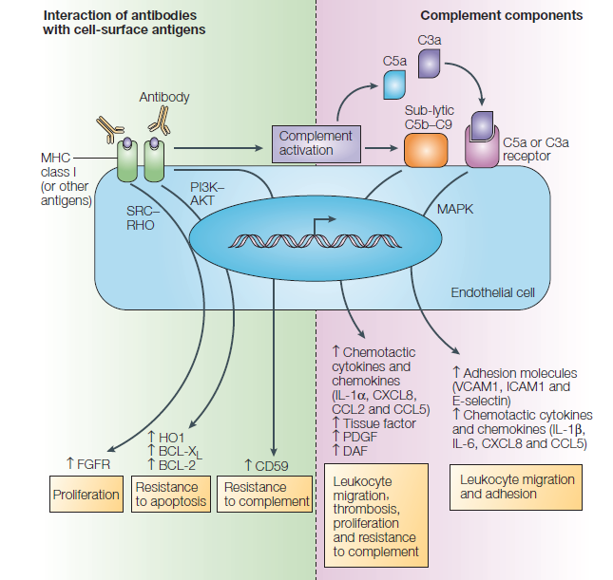
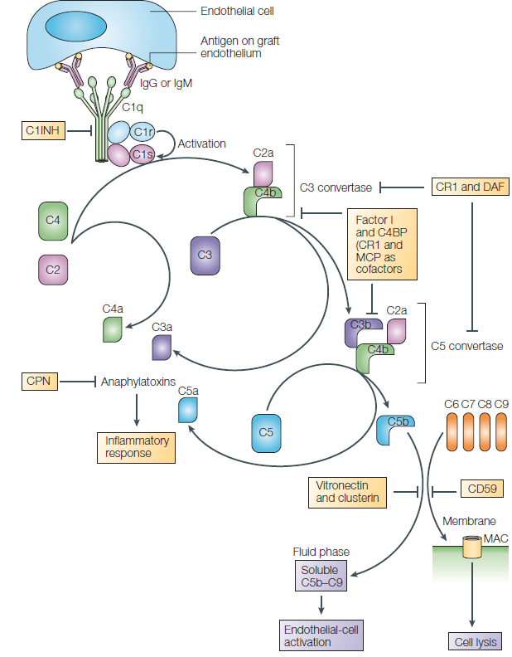
B Cells, Complement and ABMR
FPO - need simple image of complement pathway here that combines elements below
The main mechanism of antibody-mediated damage is via complement fixation
Complement fixation and activation results in tissue damage directly, through recruitment of macrophages and neutrophils and by altered endothelial gene expression which may remodel the tissue
Histologic stains of complement 4d (C4d) indicate antibody mediated rejection
Colvin RB, et al. Nature Immunology Review. 2005; 5:805-817. (image)
Notes:
The mechanism of antibody-mediated damage is most likely primarily but not exclusively through complement fixation¹⁻³
The antigenic targets of alloantibodies are mismatched MHC molecules, but antibodies that have other targets may also contribute to rejection
The targets are often found on the endothelial cells, hence the findings of vascular injury¹
Other targets include antigen-presenting cells (B lymphocytes, dendritic cells)
Endothelial damage also results in platelet activation and microthrombi formation¹
The byproducts of complement activation act as chemokines resulting in inflammation^{1,3}
Long standing inflammation results in cell proliferation^{1,3}
Histologic staining for complement 4d (C4d) in biopsies allows indirect identification of antibody deposition and complement fixation
C4d staining is strongly associated with early and late graft failure
However, recent evidence has also come to light that ABMR can also occur with C4d negative stains
Whether this is a new phenotype or due to the relative insensitivity of the staining technique – absence of C4d does not rule out ABMR
In any case, if C4d binding is detected, antibody-mediated rejection is indicated
Antibodies can also elicit damage to the graft via complement independent mechanisms
References
Puttarajappa C, Shapiro R, Tan HP. Antibody-mediated rejection in kidney transplantation: a review. J Transplant. 2012;2012:1-9.
Wood KJ, Goto R. Mechanisms of rejection: current perspectives. Transplantation. Jan 15 2012;93(1):1-10.
Colvin RB, Smith RN. Antibody-mediated organ-allograft rejection. Nature Immunology Review. 2005; 5:805-817. (image)

Slide 19
Diagnosing ABMR
In 2007, the Banff committee updated its renal allograft biopsy classification to include a separate antibody mediated rejection diagnosis¹
According to the classification, ABMR was defined as¹
Presence of DSA
Positive C4d-staining on the biopsy
Histopathological evidence of antibody-mediated injury
Histopathology then classifies ABMR into three subtypes:
Class I: Presence of acute tubular necrosis (ATN) only, with minimal inflammation
Class II: Glomerulitis, peritubular capillaritis, and microthrombosis
Class III: Arteritis
1.K. Solez, R. B, et al. Am J of Transplantation. 2008;8 (4)753–760.
Notes:
In 2007, the Banff committee updated its renal allograft biopsy classification to involve a separate antibody mediated rejection diagnosis
According to the classification, ABMR was defined as
Presence of DSA
Positive C4d-staining on the biopsy
Histopathological evidence of antibody-mediated injury
Histopathology then classifies ABMR into three subtypes:
Class I: Presence of acute tubular necrosis (ATN) only, with minimal inflammation
Class II: glomerulitis, peritubular capillaritis, and microthrombosis
Class III: Arteritis
Chronic ABMR according to the Banff criteria involves demonstration of C4d, DSA, and at least one feature of morphologic evidence of chronic tissue injury
However, situations where DSAs may be absent but histological ABMR and positive C4dstaining are present is common
References
Puttarajappa C, Shapiro R, Tan HP. Antibody-mediated rejection in kidney transplantation: a review. J Transplant. 2012;2012:1-9.
K. Solez, R. B. Colvin, L. C. Racusen et al., “Banff 07 classification of renal allograft pathology: updates and future directions,” American Journal of Transplantation, vol. 8, no. 4, pp. 753–760, 2008.

Slide 20
ABMR Histopathology
Histologic expression of acute antibody-mediated rejection
Margination of neutrophils in peritubular capillaries
Arterial fibrinoid necrosis
Thrombotic microangiopathy
Acute tubular injury
Notes:
Histologic expressions of acute antibody-mediated rejection
Margination of neutrophils in peritubular capillaries
Arterial fibrinoid necrosis
Thrombotic microangiopathy. The glomerulus contains intracapillary fibrin thrombi and also shows red blood cell stasis, suggesting poor perfusion.
Acute tubular injury. The proximal tubules appear dilated with flattening of the epithelium. Glomeruli appear unremarkable, and there is no significant interstitial inflammation or leukocyte margination in peritubular capillaries.
Magnifications: 400 in A and C; 200 in B; 100 in D (all hematoxylin and eosin [H&E] stain).
References
Racusen L, Haas M. Antibody-Mediated Rejection in Renal Allografts: Lessons from Pathology. Clin J Am Soc Nephrol 1: 415–420, 2006.

Slide 21
DeKAF C4d+ Phenotype
No C4d/No DSA (n =74) | Only DSA (n=31) | Only C4d (n=28) | Both C4d and DSA (n=40)
This is the phenotype that would implicate CNI nephrotoxicity, yet graft loss within 3 years of follow-up relatively uncommon | Reactive but not as reactive as DSA +Cd4+ group | C4d+ groups patients progressed more rapidly to allograft failure than both C4d‒ Adjusting for inflammation did not change outcome
Abbreviations:
CNI- Calcineurin Inhibitor
Cd4 – Complement 4d
DSA – Donor Specific Antibody
1. Gaston RS, et al. Transplantation. Jul 15 2010;90(1):68-74.
Notes:
DeKAF goals¹:
Proximate:
To determine the importance of C4d staining and circulating donor-specific antibody (DSA) in subsequent LGF
Long term:
Define phenotypes leading to dysfunction
Identify the risk factors and expected clinical outcomes for each phenotype
One hundred seventy-three subjects transplanted before October 1, 2005
Mean time after transplant 7.3 years +/- 6.0 years
Underwent biopsy for new onset graft dysfunction after January 2006 (study defines LGF as >90d) (mean creatinine at biopsy 2.71.6 mg/dL)
Subjects were divided into four groups based on C4d and DSA
Local diagnosis of calcineurin inhibitor nephrotoxicity was spread across all four subgroups and did not impact risk of LGF
They conclude that evidence of antibody-mediated injury (DSA or C4d) is common (57%) in patients with new onset late kidney allograft dysfunction and that the risk of subsequent graft failure is significantly worse in the presence of C4dstaining
References
Gaston RS, Cecka JM, Kasiske BL, et al. Evidence for antibody-mediated injury as a major determinant of late kidney allograft failure. Transplantation. Jul 15 2010;90(1):68-74.

Slide 22
Cd4- Phenotype - Impact to Banff Guidelines
Sis and Halloran identified C4d negative phenotype²
Twice as common as C4d-positive ABMR
C4d staining, although very useful, is insensitive for detecting ABMR
C4d negative cases with anti-HLA and microcirculation are identified as ‘suspicious for ABMR’¹
Einecke et al., suggest that they be designated ABMR given the similarities in microcirculation lesions and prognosis^{1,2}
These histologic features may occur at an early stage in the progression of antibody mediated graft injury¹
Einecke G, et al. Am J Transplant. 2009; 9: 2520–2531.
Einecke G, et al. Am J Transplant. 2010; 10:953.
Notes:
Sis & Halloran identified C4d-negative phenotype
Twice as common as C4d-positive ABMR²
C4d staining, although very useful, is insensitive for detecting ABMR²
Measuring endothelial gene expression in biopsies from kidneys with alloantibody is a sensitive and specific method to diagnose ABMR and predict graft outcomes²
The C4d negative cases with anti-HLA and microcirculation previously been identified as ‘suspicious for ABMR’
Eineck et al suggest that they be designated ABMR at future Banff meetings given the similarities in microcirculation lesions and prognosis
The presence and predictive value of microcirculation lesions in the absence of C4d in protocol biopsies in clinically stable patients suggests that these histologic features occur at an early stage in the progression of antibody mediated graft injury
References
Einecke G, Sis B, Reeve J et al. Antibody-mediated microcirculation injury is the major cause of late kidney transplant failure. Am J Transplant. 2009; 9: 2520–2531.
Einecke G, Halloran, PF. Antibody-mediated microcirculation injury is the major cause of late kidney transplant failure: Response to Dr. Loupy et al. Am J Transplant. 2010; 10:953.
Loupy A, Suberbielle-Boissel C, Hill GS et al. Outcome of subclinical antibody-mediated rejection in kidney transplant recipients with preformed donor-specific antibodies. Am J Transplant 2009; 9: 2561–2570.

Slide 23
New Algorithm for ABMR Detection
Microcirculation inflammation was the first Banff histology marker for ABMR, followed by Cd4 staining
In order to capture instances where there is inflammation, possible DSA presence, but C4d negative stains, a new algorithm was created
It suggests the best predictor of DSA is a scoring system that weights glomerulitis (g) + peritubluar capillaritis (ptc) and factors in time post-transplant followed by presence of C4d
Abbreviation
DSA – Donor Specific Antibody
1. Sis, B, et al. Am J Transplant 2012; 12: 1168–1179.
Notes:
According to Banff criteria, glomerulitis and/or peritubular capillaritis in kidney transplant biopsies are diagnostic lesions for ABMR when accompanied by diffuse C4d staining and DSA
However, many C4d - transplants manifest glomerulitis and/or peritubular capillaritis associated with circulating DSA and a poor prognosis
Sis et al studied the significance of microcirculation inflammation in kidney transplants, including 329 indication biopsies from 251 renal allograft recipients, who were mostly nonpresensitized (crossmatch negative)
Glomerulitis (g) and peritubular capillaritis (ptc) were often associated with antibody-mediated rejection, but were also found in other diseases in the absence of DSA:
T-cell-mediated rejection (ptc, g)
Glomerulonephritis (g)
Acute tubular necrosis (ptc)
To develop rules for reducing the nonspecificity of microcirculation inflammation and defining the best grading thresholds associated with DSA, they built and validated a decision tree to predict DSA
The decision tree revealed:
best predictor of DSA was g + ptc sum (addition of g-score plus ptc-score)
Then time posttransplant
Then C4d, which had a small role
They purport that their decision tree predicted DSA with higher sensitivity and accuracy than C4d staining and that “any degree of microcirculation inflammation in late kidney transplant biopsies strongly indicates presence of DSA and predicts progression to graft failure”
References
Sis, B., Jhangri, G. S., Riopel, J., Chang, J., de Freitas, D. G., Hidalgo, L., Mengel, M., Matas, A. and Halloran, P. F. A New Diagnostic Algorithm for Antibody-Mediated Microcirculation Inflammation in Kidney Transplants. Am J Transplant 2012; 12: 1168–1179.

Slide 24
Clinical Relevance of New Developments
The goal is to refine diagnostics so that all instances of immune mediated rejection are caught
To do this, much work still needs to be done and is being done presently with independents labs and Banff Working Groups
Two key takeaways for clinical practice are:
Immune mediated rejection is occurring more frequently than previously thought and that requires an adjustment away from looking at CNI therapy to prevent rejection
Given the C4d negative phenotype in ABMR – if ABMR is suspected, but the C4d is negative, ABMR should no be ruled out from the differential diagnosis if the other markers are present

Slide 25
Laboratory Diagnostics

Slide 26
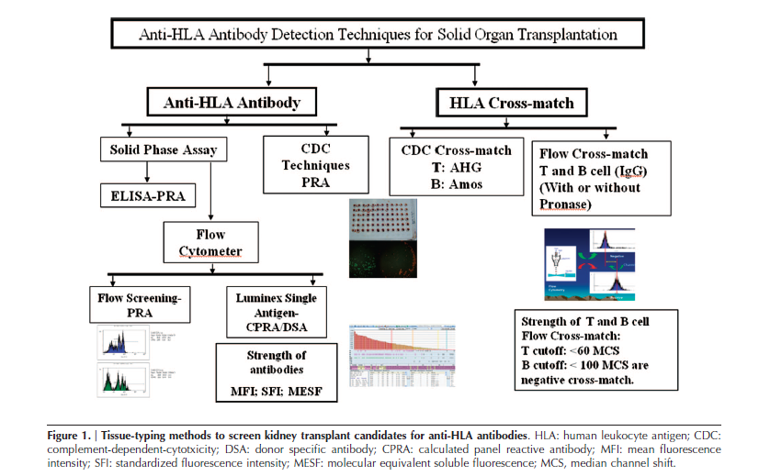
The Current State of Laboratory Diagnostics
Marfo K. Clin J Am Soc Nephrol 2011 922-936.
Notes:
Currently used:
Enzyme-linked immune assays
Enzyme-linked immunosorbent spot (ELISPOT)
FluoroSpot assay
Panel reactive antibody (PRA) screening
Flow cytometric crossmatching (FCXM)
References
Marfo K Clin J Am Soc Nephrol 2011 922-936; pg 928/fig1

Slide 27
Critical Updates to the Diagnostic Repertoire
A critical outcome of a better understanding of the MOD of immunologic injury is the ability to update detection and diagnostic assays¹
New diagnostics:
Endothelial gene expression is a sensitive and specific method to diagnose ABMR and predict graft outcomes²
C1q-Fixing HLA antibodies have been shown to be specific for detecting late graft failure and transplant glomerulopathy³
RNA genetic markers of Tregs which targets FoxP3^{4,5}
Diagnostics being reevaluated:
Inflammatory markers
Associated with poor prognosis in ABMR⁶
But have some association with good prognosis in TCMR, if there is no presence of ABMR⁷
C4d staining and serum creatinine alone are not specific enough to catch all instances of ABMR^{2,3,5}
Halloran PF. N Engl J Med 2004;351:2715-29.
Sis B, et al. Curr Opin Organ Transplant. Feb 2010;15(1):42-48.
Yabu JM, et al. Transplantation. Feb 15 2011;91(3):342-347.
Muthukumar Dadhania TD, Ding R, et al. N Engl J Med. 2005;353:2342-51.
Quest Diagnostics Launches First Molecular Test for Kidney Organ Transplant Rejection. Press Release. Accessed on November 1, 2012.
Gaston RS, Transplantation. Jul 15 2010;90(1):68-74.
Famulski KS, et al. Am J Transplant. Apr 2010;10(4):810-820.
Notes:
References
Halloran PF. Immunosuppressive Drugs for Kidney Transplantation. N Engl J Med 2004;351:2715-29.
Sis B, Halloran PF. Endothelial transcripts uncover a previously unknown phenotype: C4d-negative antibody-mediated rejection. Curr Opin Organ Transplant. Feb 2010;15(1):42-48.
Yabu JM, Higgins JP, Chen G, Sequeira F, Busque S, Tyan DB. C1q-fixing human leukocyte antigen antibodies are specific for predicting transplant glomerulopathy and late graft failure after kidney transplantation. Transplantation. Feb 15 2011;91(3):342-347.
Muthukumar Dadhania TD, Ding R, et al. Messenger RNA for FOXP3 in the Urine of Renal-Allograft Recipients. N Engl J Med. 2005;353:2342-51.
Quest Diagnostics Launches First Molecular Test for Kidney Organ Transplant Rejection. Press Release. http://ir.questdiagnostics.com/phoenix.zhtml?c=82068&p=irol-newsArticle&ID=1673293&highlight Accessed on November 1, 2012.
Gaston RS, Cecka JM, Kasiske BL, et al. Evidence for antibody-mediated injury as a major determinant of late kidney allograft failure. Transplantation. Jul 15 2010;90(1):68-74.
7. Famulski KS, Einecke G, Sis B, et al. Defining the canonical form of T-cell-mediated rejection in human kidney transplants. Am J Transplant. Apr 2010;10(4):810-820.

Slide 28
ABMR Treatment Strategies
Current therapies used for treatment of acute and chronic ABMR include:
Plasmaphersis¹
Intravenous immunoglobulin (IVIG) ¹
B cell depletion protocols¹
T cell depletion protocols¹
Terminal complement inhibition¹
Modifications to maintenance immunosuppresive drugs²
Webber A, et al. Transplantation. 2011;91:1057–1064.
Chandraker A, et al. Chapter 282. Harrison's Principles of Internal Medicine. 18th ed. New York: McGraw-Hill; 2012.
Notes:
1. Webber A, Hirose R, Vincenti F. Novel Strategies in Immunosuppression: Issues in Perspective. Transplantation. 2011;91:1057–1064.
2. Chandraker A, Milford EL, Sayegh MH. Chapter 282. Transplantation in the Treatment of Renal Failure. In: Longo DL, Fauci AS, Kasper DL, Hauser SL, Jameson JL, Loscalzo J, eds. Harrison's Principles of Internal Medicine. 18th ed. New York: McGraw-Hill; 2012.

Slide 29
Summary

Slide 30
Summary
Immunologic mediated rejection is an underestimated problem
Understanding the MOD of immunologic injury is critical to moving forward in transplantation and can:
Facilitate the identification of targets for the development of improved immunosuppressive therapies
Add precision to histological guidelines
Detecting more instances of this type of rejection or excluding it from the differential – therein improving treatment
Enable new types of detection and monitoring assays to be created
1. Sis B, et al. Curr Opin Organ Transplant. Feb 2010;15(1):42-48.
2. Webber A, et al. Transplantation. 2011;91:1057–1064.
3. Halloran PF. N Engl J Med 2004;351:2715-29.
Notes:
References

